Slide 1




INFOSYS SPRINGBOARD · VIRTUAL INTERNSHIP 7.0
Cyber Threat Analytics
Platform & Incident
Visualization System
An end-to-end Power BI business-intelligence solution that turns 40,000 raw cybersecurity events into clear, actionable threat intelligence.
SECURITY INTELLIGENCE FRAMEWORK
PRESENTED BY Ponnuru Nithin Mentor · Ms. Nithyasri S J
40,000 Incidents
7 Dashboards
28 States

Slide 2




01 · PROJECT OBJECTIVES
What the framework set out to achieve
01
02
Consolidate & Model Data
Detect & Quantify Threats
Unify 40,000 raw cybersecurity incident records into a single, coherent Power BI analytical framework.
Identify attack patterns, severity levels and anomaly behaviour across attack types, protocols and geography.
03
04
Monitor Behaviour & Response
Communicate Intelligence
Track network traffic, user/device behaviour and how effectively incidents are blocked, logged or ignored.
Convert complex log data into clear KPIs and visuals for both technical analysts and non-technical audiences.

Slide 3




02 · PROJECT DESCRIPTION
Seven interconnected dashboards
The Advanced Threat Incident Analytics & Security Visualization Framework is built entirely in Microsoft Power BI on a 40,000-record Kaggle dataset spanning Jan 2020–Oct 2023 across 28 Indian states. It transforms raw log data into seven themed, drill-able dashboards that give a 360° view of the threat landscape.
MODULE 1
MODULE 2
MODULE 3
Cyber Security Attacks Analysis
Threat Detection & Anomaly
Network Traffic Analysis
KPI overview of attack volume, type, action and geographic spread.
Anomaly-score bands, gauge and interactive slicer-driven investigation.
Protocol, packet-type and severity behaviour across the network.
MODULE 4
MODULE 5
MODULE 6
User Behaviour Analytics
Threat Profile & Severity
Alert Monitoring & Response
OS/browser mix, user & device metrics and top high-anomaly source IPs.
Decomposition tree, signatures and severity mix by network segment.
Alert / IDS coverage, block-rate trends and response effectiveness.

Slide 4







03 · TOP VISUALIZATIONS / COMPONENTS USED
The visual toolkit behind the framework
VISUAL TYPE
PURPOSE / WHAT IT SHOWS
KPI Cards & Gauges
Headline metrics - Total Attacks (40K), High Severity, Block Rate % and Malware Detected.
Donut & Pie Charts
Composition of attack types, action taken and anomaly-score bands at a glance.
Decomposition Tree
Interactive drill from total attacks → attack type → severity level.
Geographic Map
Attack volume and type plotted across 28 Indian states and cities.
Ribbon & Waterfall
Rank shifts of attack types over time and block-rate contribution by class.
Sankey Diagram
Flow of every attack type into its Blocked / Ignored / Logged outcome.
Gauge & Key Influencers
Average anomaly score and the factors that drive a 'Blocked' outcome.

Slide 5
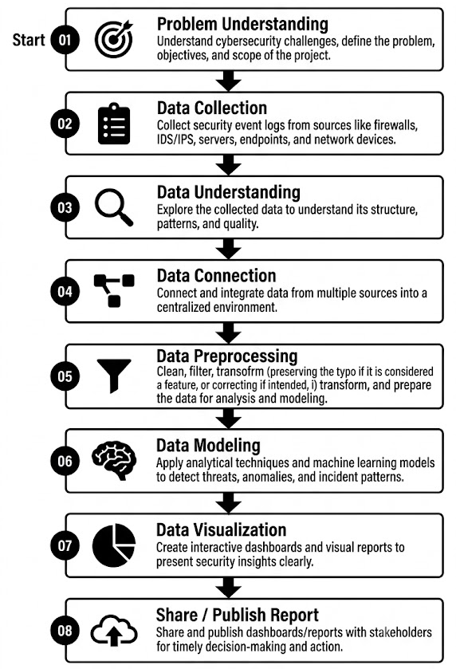
04 · PROJECT WORKFLOW
The eight-stage Power BI pipeline

Slide 6
04.1 · PROJECT WORKFLOW
The eight-stage Power BI pipeline
End-to-End Cybersecurity Analytics Workflow
1. Problem Understanding The project began by identifying key cybersecurity questions: number and types of attacks, severity, anomaly behaviour, network activity, user behaviour, and effectiveness of security responses. KPIs such as Total Attacks, High Severity, Malware Detected, Average Anomaly Score and Block Rate were defined for analysis.
2. Data Collection A publicly available 40,000-record cybersecurity dataset from Kaggle, covering January 2020 to October 2023, was collected. It contained information on IPs, protocols, attack types, severity, malware indicators, anomaly scores, devices, operating systems, browsers and geography.
3. Data Understanding The collected data was explored to understand its structure, variables, categories, quality and analytical potential. Key dimensions such as DDoS, Malware, Intrusion; Low, Medium, High severity; TCP, UDP, ICMP; and Blocked, Logged, Ignored were identified for further analysis.
4. Data Connection The dataset was imported into Microsoft Power BI, with Power Query used as the ETL environment. A structured data model was established, including a dedicated Date table and relationships to ensure consistent filtering and analysis across dashboards.
5. Data Preprocessing The raw data was cleaned and transformed through 19 Power Query steps. This included removing duplicates, correcting data types, handling missing values, splitting location fields into City and State, extracting browser information, removing unnecessary payload data, creating a Severity Sort key, and grouping anomaly scores into four bands: 0–25, 26–50, 51–75 and 76–100.
6. Data Modeling The cleaned data was structured for analysis using a Date table, relationships and DAX measures/calculated columns. Key calculations included Total Attacks, High Severity, % High Severity, Malware Detected, Average Anomaly Score, Block Rate and Anomaly Score Band.
7. Data Visualization The analysis was converted into five interactive Power BI dashboards: Cyber Security Attacks Analysis, Threat Detection & Anomaly Analysis, Network Traffic Analysis, User Behaviour Analytics, and Threat Profile & Severity Breakdown. Slicers, cross-filtering and advanced visuals enabled users to explore threats from overview to detailed analysis.
8. Share / Publish Report The final insights were documented in the Milestone 3 report and PowerPoint presentation, while the .pbix file and supporting artefacts were maintained through GitHub. The project was reviewed with the mentor through Microsoft Teams and prepared for stakeholder access through Power BI publishing.

Slide 7
05 · PROJECT EXECUTION MILESTONES
How the project was delivered
M1
M2
M3
M4
MILESTONE 1
MILESTONE 2
MILESTONE 3
MILESTONE 4
Data Modeling
Data Modeling
Development
Review & Optimization
Sourced the 40,000-record Kaggle dataset and shaped it through 19 Power Query steps - types, nulls, date/time split and category standardisation.
Built and marked a Date table, established relationships and authored core DAX measures and the Anomaly Score Band logic.
Designed the seven themed dashboards with slicers, cross-filtering, decomposition tree, ribbon, treemap and Sankey visuals.
Validated figures across visuals, optimised model performance, and consolidated the report, PPT and GitHub repository.

Slide 8
05.1 · PROJECT EXECUTION MILESTONES
How the project was delivered
MILESTONE 1 - Data Foundation & Understanding
Focus: Preparing reliable data for analysis
Collected and validated 40,000 cybersecurity records from Kaggle.
Explored data structure, variables and cybersecurity dimensions.
Cleaned and transformed data using Power Query.
Handled missing values, duplicates, errors and incorrect data types.
Created Date, City, State, Browser, Severity Sort and Anomaly Score Bands.
Built the Date table, relationships and basic KPIs.
Outcome: Clean, structured and analysis-ready cybersecurity dataset.
MILESTONE 2 - Core Dashboards & Behavioural Analytics
Focus: Converting data into interactive security analytics
Developed dashboards for Attack Analysis, Threat/Anomaly Detection, Network Traffic and User Behaviour.
Analysed attack types, severity, protocols, packet types, geography, browsers and operating systems.
Added KPIs, slicers, cross-filtering and interactive navigation.
Identified patterns across attacks, network activity and user/device behaviour.
Outcome: Interactive dashboards providing a comprehensive view of the cybersecurity environment.
MILESTONE 3 - Advanced Threat Profiling, Insights & Reporting
Focus: Deep analysis and final reporting
Developed the Threat Profile & Severity Breakdown dashboard.
Applied Decomposition Tree, Ribbon Chart, Treemap and Severity Matrix.
Analysed Attack Type × Severity, Network Segment, Anomaly Bands and Threat Signatures.
Created advanced KPIs including % High Severity, Malware Detected and Block Rate.
Validated insights across dashboards and documented the findings.
Prepared the Word report, PowerPoint presentation and GitHub project artefacts.
Outcome: Complete cybersecurity analytics framework with validated and actionable insights.
MILESTONE 4 - Future Enhancement & Deployment
Focus: Taking the framework toward a more advanced, operational solution
Integrate near-real-time cybersecurity data using Scheduled Refresh or DirectQuery.
Introduce predictive analytics for anomaly forecasting and risk scoring using Python/R or Azure ML.
Implement Row-Level Security (RLS) for role-based access, such as SOC analysts and managers.
Create automated alerts for critical threshold breaches using Power Automate.
Add drill-through to individual incident details and improve geographic analysis with a true India choropleth map.
Deploy the solution more broadly through Power BI Service/App Workspace.
Outcome: A more automated, predictive, secure and operational cybersecurity intelligence platform.

Slide 9
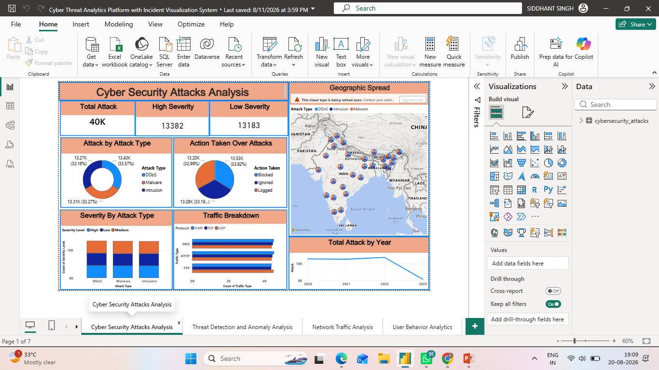
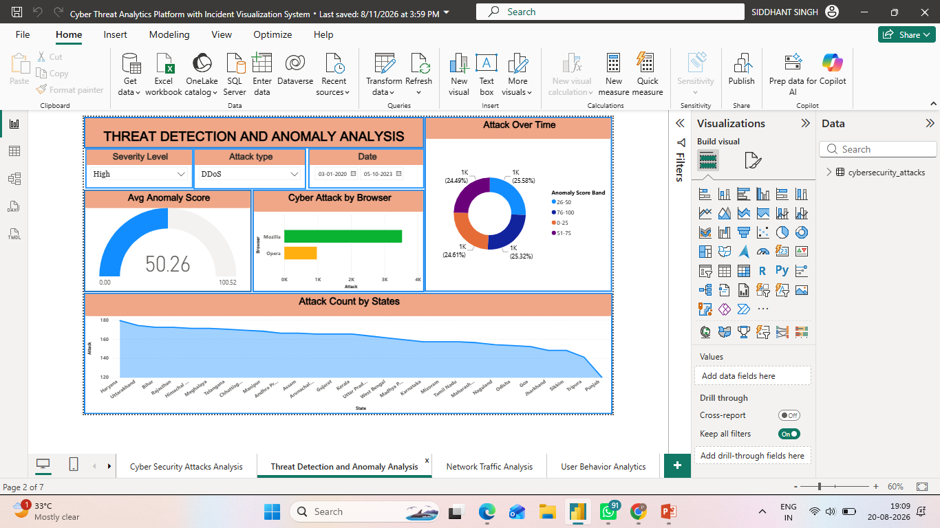
01 Dashboard 1 - Cyber Security Attacks Analysis
02 Dashboard 2 - Threat Detection & Anomaly Analysis
• Executive overview of the 40,000-event dataset, using KPI cards to surface total attacks, high-severity events and low-severity events at a glance.
• Attack-type visuals compare DDoS, Malware and Intrusion, while the action chart separates Blocked, Ignored and Logged outcomes to show response distribution.
• The geographic map places attack activity across India and nearby regions, helping analysts connect attack type with location and identify concentration areas.
• Yearly trend, severity mix and traffic breakdown visuals provide a compact view of how attack volume, severity and protocol activity change over time.
• Focuses on anomaly behaviour by combining severity, attack type and date slicers with an average anomaly-score KPI for targeted investigation.
• The Attack Over Time donut groups events by anomaly-score bands, allowing analysts to distinguish lower-score activity from higher-score observations.
• Cyber Attack by Browser compares browser-related attack volume, while the state chart highlights how attack counts vary across the listed states.
• The page is designed for drill-down analysis: users can narrow the view with severity, attack type and date selections and observe the visuals update together.

Slide 10
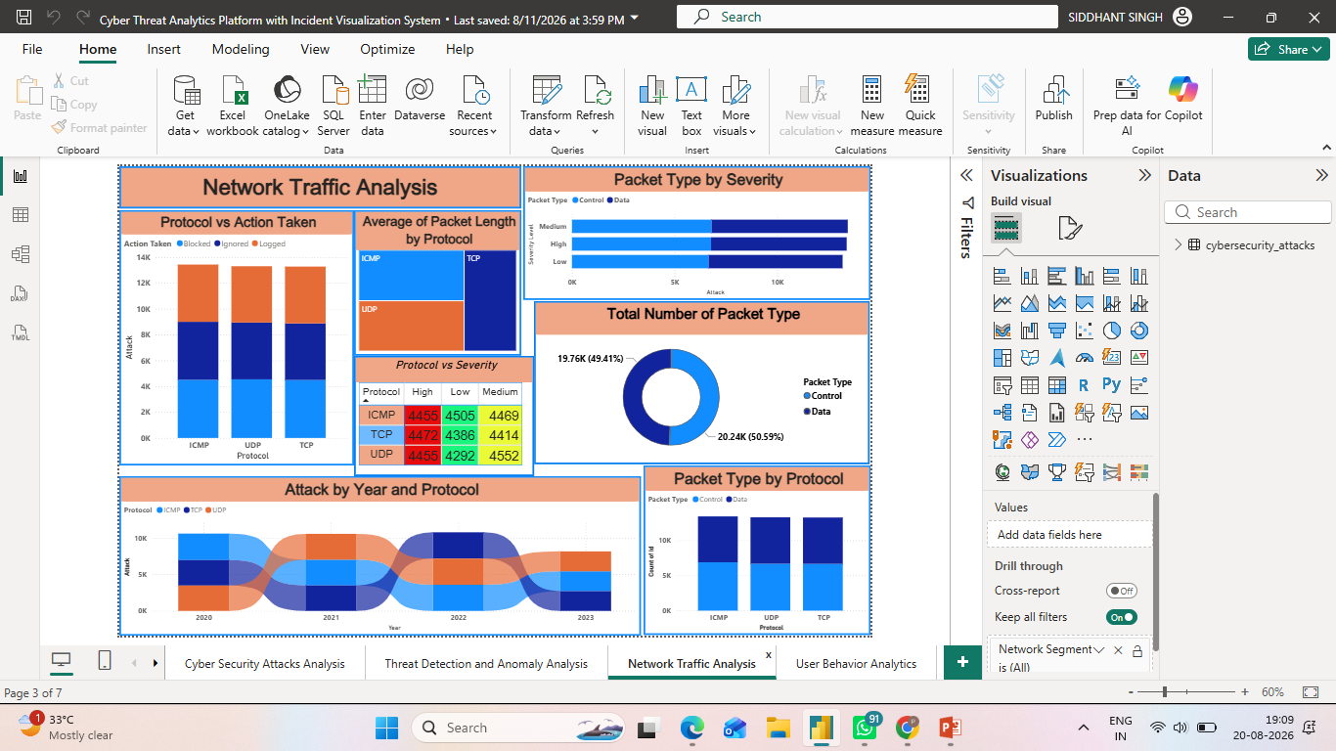
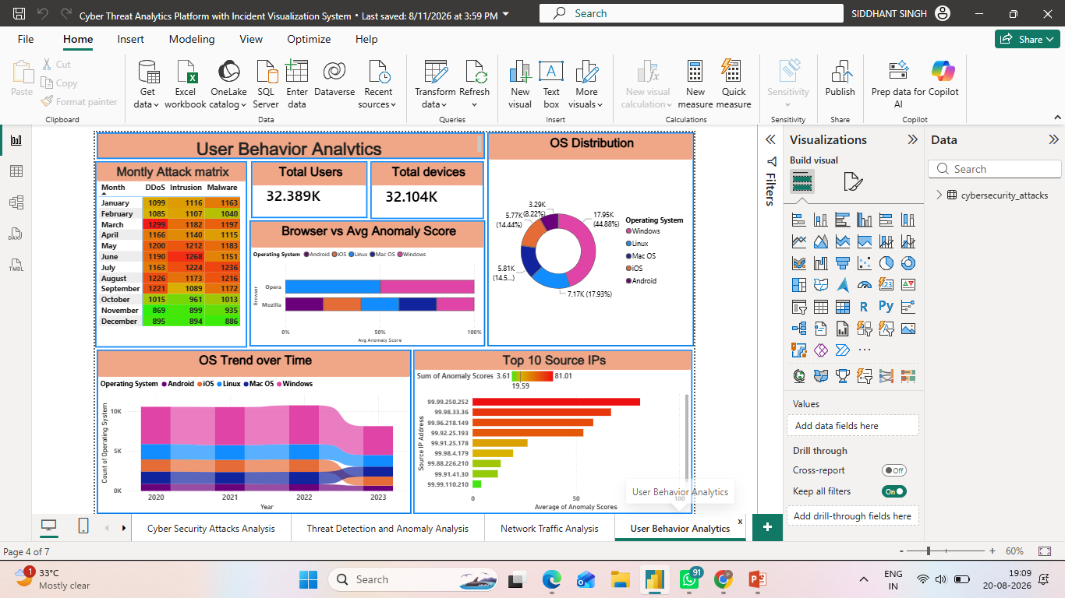
03 Dashboard 3 - Network Traffic Analysis
04 Dashboard 4 - User Behaviour Analytics
• Examines network activity through protocol, packet type, severity and action-taken dimensions, with ICMP, UDP and TCP as the core protocol categories.
• The stacked Protocol vs Action Taken chart shows how Blocked, Ignored and Logged outcomes distribute across protocols, supporting response comparison.
• Packet Type by Severity and Total Number of Packet Type expose the Control/Data mix, while the protocol treemap summarises average packet length.
• The year-and-protocol flow visual helps track how protocol composition changes over time, making it easier to spot shifts in network behaviour.
• Summarises user/device context with total users and total devices, then connects browser behaviour to anomaly scores and operating-system distribution.
• The monthly attack matrix compares DDoS, Intrusion and Malware across the year, making seasonal or month-level differences visible in a compact table.
• OS Distribution and the OS Trend over Time show the relative presence of Windows, Linux, Mac OS, iOS and Android across the dataset period.
• Top 10 Source IPs ranks high-scoring sources, giving analysts a practical starting point for prioritising suspicious origins for deeper investigation.

Slide 11
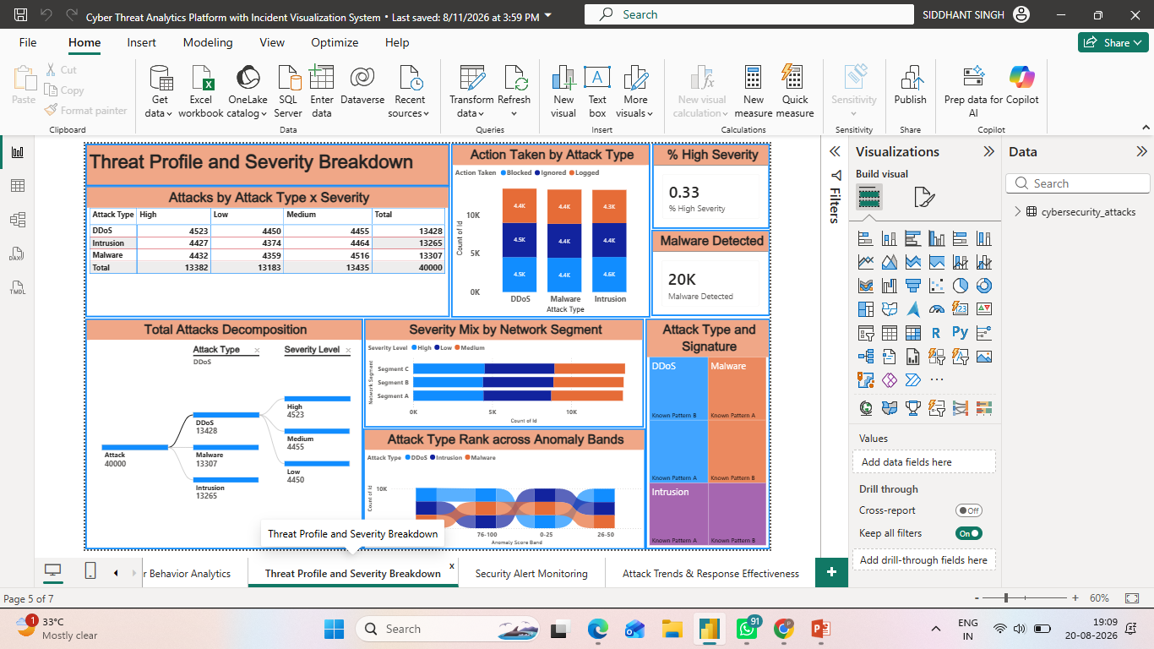
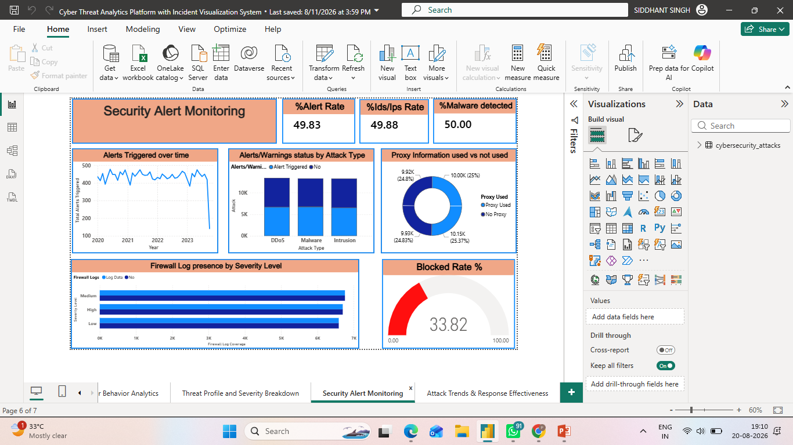
05 Dashboard 5 - Threat Profile & Severity Breakdown
06 Dashboard 6 - Security Alert Monitoring
• Provides a detailed threat profile by combining attack type with High, Low and Medium severity counts; the table exposes the exact breakdown behind the totals.
• Action Taken by Attack Type compares Blocked, Ignored and Logged responses for DDoS, Malware and Intrusion, making response imbalance visible.
• The % High Severity and Malware Detected KPI cards turn the detailed dataset into quick executive indicators, while the decomposition tree supports guided exploration.
• Severity Mix by Network Segment, anomaly-band ranking and the attack-type/signature treemap connect severity, network segments and known patterns into one investigative view.
• Monitors alert activity over time and reports three headline rates: overall alert rate, IDS/IPS rate and malware-detected rate.
• Alerts/Warnings status by Attack Type compares triggered vs non-triggered status for DDoS, Malware and Intrusion, helping identify where alerting is concentrated.
• Proxy Information used vs not used shows the balance of proxy context, while firewall-log presence by severity indicates log coverage for High, Medium and Low events.
• The Blocked Rate gauge converts response activity into an easy-to-read percentage, complementing the time-series and categorical monitoring views.

Slide 12
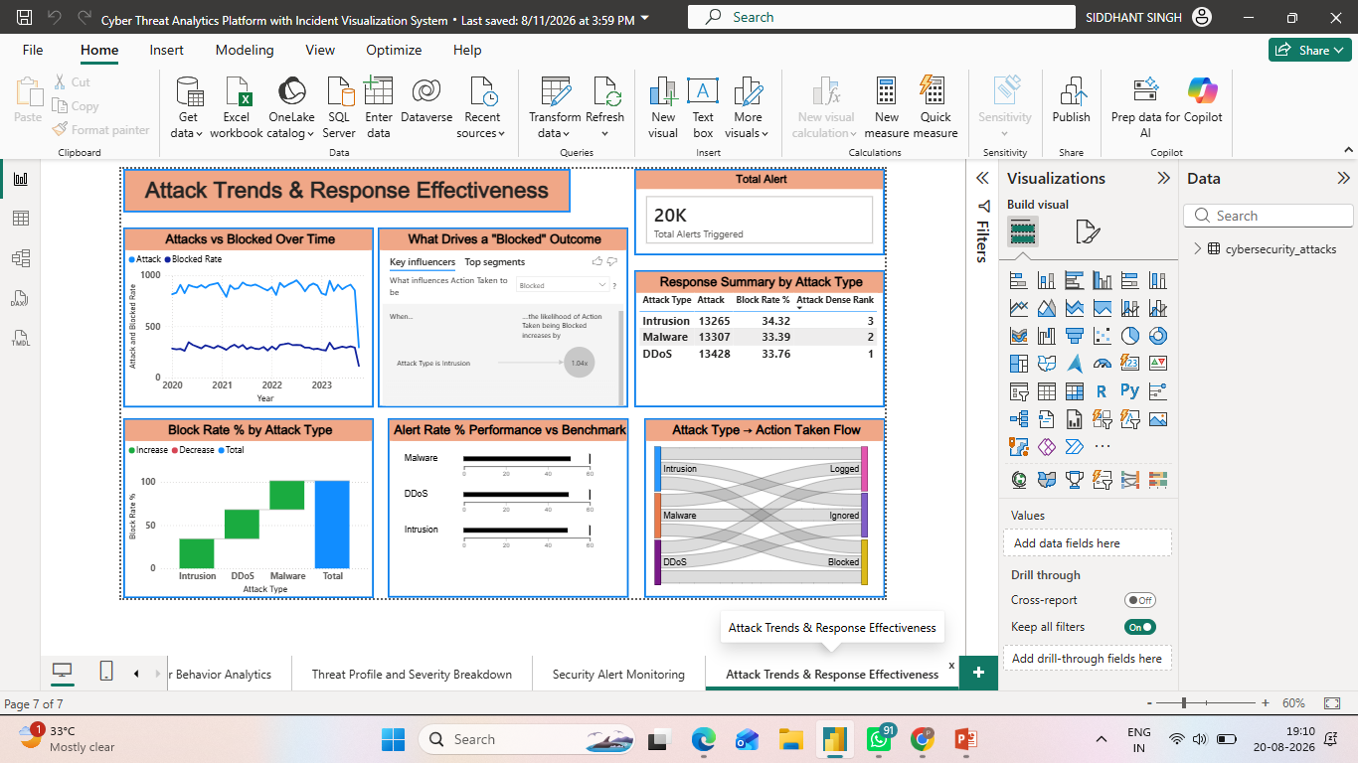
07 Dashboard 7 - Attack Trends & Response Effectiveness
• Combines attack volume and blocked-rate trends with a response summary table, making it the strongest page for evaluating response effectiveness by attack type.
• The response table ranks DDoS, Malware and Intrusion by attack density and block rate, while the waterfall visual compares relative block-rate performance.
• The benchmark visual places alert-rate performance against a reference scale, and the Sankey flow traces each attack type into Blocked, Ignored and Logged outcomes.
• Together, the visuals highlight the central response question: how much malicious activity is detected, how much is blocked, and where the remaining gap sits.

Slide 13


06 · CHALLENGES & RESOLUTIONS
Obstacles met and how the team solved them
CHALLENGES
RESOLUTIONS
1. Maintaining performance with a 40,000-row dataset - Keeping the Power BI model responsive while multiple visuals, KPIs and interactive filters operated simultaneously was a key performance challenge. | Optimised the data model and DAX - Used efficient DAX measures and disabled unnecessary automatic date/time tables to reduce model overhead and maintain dashboard responsiveness.
2. Designing reliable derived metrics - Measures such as % High Severity, Block Rate %, Malware Detected and Anomaly Score Bands had to produce accurate results under different slicers and filter combinations. | Iterative testing and validation - Each measure was repeatedly tested across different slicers, visual interactions and filter contexts to ensure consistent and reliable outputs.
3. Handling and transforming raw cybersecurity data - The dataset required multiple cleaning and transformation operations, including missing values, duplicates, data types, geographic fields and derived analytical columns. | Structured Power Query preprocessing - The team applied a systematic transformation workflow to clean, standardise and prepare the data before modelling and dashboard development.
4. Maintaining consistency across dashboards - Different analytical views required a common visual language, severity representation, KPI structure and filtering experience, particularly when dashboards were developed collaboratively. | Standardised design and collaboration - Common colours, severity encoding, KPI conventions and dashboard layouts were followed, while Microsoft Teams and GitHub supported coordination and integration of team contributions.
5. Ensuring analytical accuracy and meaningful insights - With multiple dimensions such as attack type, severity, network segment, anomaly bands and threat signatures, maintaining consistency between visuals and conclusions was challenging. | Cross-dashboard validation and analytical review - Findings were compared across dashboards and validated before being incorporated into the final report and presentation, helping ensure that the reported insights remained consistent with the underlying data.

Slide 14


07 · LEARNINGS & SKILLS ACQUIRED
What this internship built
TECHNICAL SKILLS
SOFT SKILLS
Power BI & Power Query - Data cleaning, transformation, ETL and dashboard development.
Data Modelling & DAX - Built relationships, Date tables, calculated columns, measures and KPI logic.
Cybersecurity Analytics - Analysed attack types, severity, anomaly scores, network traffic, users and threat signatures.
Advanced Visualization - Developed interactive dashboards using slicers, cross-filtering, Decomposition Tree, Treemap, Ribbon Chart and other visuals.
Data Validation & Reporting - Cross-checked analytical results and converted findings into structured reports and presentations.
Collaboration & Version Control - Used Microsoft Teams and GitHub to coordinate development and maintain project artefacts.
Problem Solving - Tackled data-quality, modelling, performance and analytical challenges systematically.
Analytical Thinking - Converted large volumes of raw security data into meaningful patterns and insights.
Teamwork & Collaboration - Coordinated dashboard development and integrated contributions across team members.
Communication - Presented technical findings in a clear and understandable manner for different stakeholders.
Presentation Skills - Developed and delivered structured project reports and dashboard walkthroughs.
Decision-Oriented Thinking - Learned to connect analytical findings with practical cybersecurity actions and recommendations.
OVERALL EXPERIENCE Hands-on mastery of Power BI, DAX and analytical storytelling - reinforcing the real-world value of data-driven, evidence-based decision-making.

Slide 15

08 · FUTURE ENHANCEMENTS & KEY INSIGHTS
Where the framework goes next
KEY INSIGHTS
FUTURE ENHANCEMENTS
33.6%
DDoS marginally leads a broad, multi-vector threat mix (Malware 33.3%, Intrusion 33.2%).
Integrate near-real-time data via scheduled refresh or DirectQuery
Add predictive analytics - anomaly forecasting & risk scoring (Python / R / Azure ML)
Row-level security for role-based dashboards + automated alerting via Power Automate
Drill-through to raw incidents, a true India choropleth, and publish to the Power BI Service
~45%
Windows is the most-targeted OS; malware indicators appear in exactly 50% of events.
33.8%
Only about a third of attacks are actively blocked - a clear, quantified response gap.

Slide 16


09 · CONCLUSION
From raw events to intelligence
The Cyber Threat Analytics Platform successfully transformed 40,000 raw cybersecurity incidents into seven interactive Power BI dashboards - delivering a complete, drill-able view of the threat landscape for technical and non-technical audiences alike.
Technical Impact
Practical Experience
Overall Outcome
The Cyber Threat Analytics project successfully ingested and transformed over 40,000 raw cybersecurity incident records into seven interactive Power BI dashboards. By executing a complete end-to-end Business Intelligence pipeline, the initiative achieved hands-on mastery of advanced DAX calculations, relational data modeling, and dynamic data visualization-converting fragmented technical logs into structured, drill-able security intelligence accessible to both SOC analysts and non-technical stakeholders.
Applying business intelligence directly to security monitoring provided actionable clarity on operational strengths and gaps. Most notably, the platform quantified a critical threat landscape baseline: only approximately one-third (~33%) of identified incidents were actively blocked by existing automated mechanisms. This key finding gives leadership data-driven justification to enhance automated threat containment strategies while laying a robust analytical foundation for future security monitoring and incident response initiatives.
End-to-End Intelligence Pipeline: Successfully converted 40,000 raw cybersecurity event logs into seven multi-dimensional, interactive Power BI dashboards for real-time monitoring.
Technical Mastery: Demonstrated full lifecycle BI capability-including custom DAX modeling, relational schema architecture, and multi-layered analytical storytelling.
Operational Bridge: Connected raw technical event telemetry with high-level executive decision-making, providing seamless drill-down capabilities for both engineers and leadership.
Quantified Posture Gap: Identified that only ~33% of detected threats were actively blocked, delivering clear data evidence to drive automated threat response improvements and guide future security roadmap investments.

Slide 17


10 · ACKNOWLEDGEMENTS & REFERENCES
With gratitude
We would like to express our sincere gratitude to the Infosys Springboard Team for organizing this highly enriching virtual internship program and for providing a structured, industry-aligned learning platform. The well-designed modules, milestone-based framework, and practical orientation of the internship enabled us to gain meaningful exposure to real-world business intelligence applications.
We extend our heartfelt appreciation to our mentor, Ms. Nityasree, for her consistent guidance, valuable feedback, and continuous encouragement throughout the project lifecycle. Her insights and structured direction played a significant role in shaping the analytical depth and professional quality of this project. We would also like to acknowledge our team members for their strong collaboration, accountability, and shared commitment toward achieving project objectives. The coordinated distribution of responsibilities, open communication, and collective problem-solving approach significantly contributed to the successful execution of this project.
In addition, we extend our appreciation to the creators and maintainers of Microsoft Power BI documentation and community resources, which served as essential references during dashboard development and KPI implementation. We are also grateful to Kaggle for providing access to publicly available datasets that facilitated practical, hands-on analytical experience.The structured learning resources and practical exposure provided through this internship have significantly strengthened our analytical thinking, technical proficiency, and business interpretation skills. This experience has enhanced our ability to approach data with a strategic mindset, collaborate effectively within a team environment, and execute projects with professional discipline. Overall, this internship has been a meaningful milestone in our academic and professional journey, reinforcing the value of data-driven decision-making and structured analytical execution in modern business environments.
ACKNOWLEDGEMENTS
REFERENCES
Kaggle - “Cyber Security Attacks” dataset (40,000 records, 2020–2023)
Microsoft Power BI & DAX official documentation and community resources
Infosys Springboard learning modules and training materials

Slide 18
Thank You
Cyber Threat Analytics Platform with Incident Visualization System
Siddhant Singh · Infosys Springboard Virtual Internship 7.0 · Mentor: Ms. Nithyasri S J

